Slide 1

Project 1 Report

Slide 2
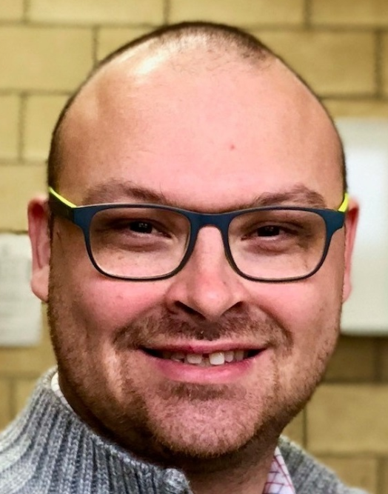
Introduction to self
Matthew (“Matt”)
Previous roles:
Lecturer/Psychologist
Social/Market/Employee Research

Slide 3

Project Overview
Pokémon Go!
One of the most successful games in the world
Requires users to ‘find’ Pokemon in wild
Users physically ‘active’

Slide 4

But what is there for “lazy” people?

Slide 5
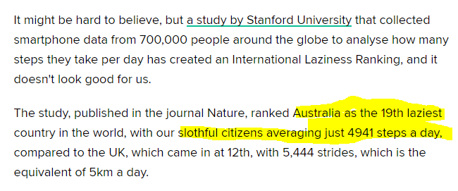
Market Opportunity!
Large market for ‘lazy’ inactive gamers!
Source: https://www.huffingtonpost.com.au/adam-macdougall/australias-position-on-the-international-laziness-ranking-sugge_a_23060785/

Slide 7

General project experience
General programming
“Brute Force”
Dictionary Frustrations
List and Dictionary Comprehension
(Thank you Jacob ☺)

Slide 8
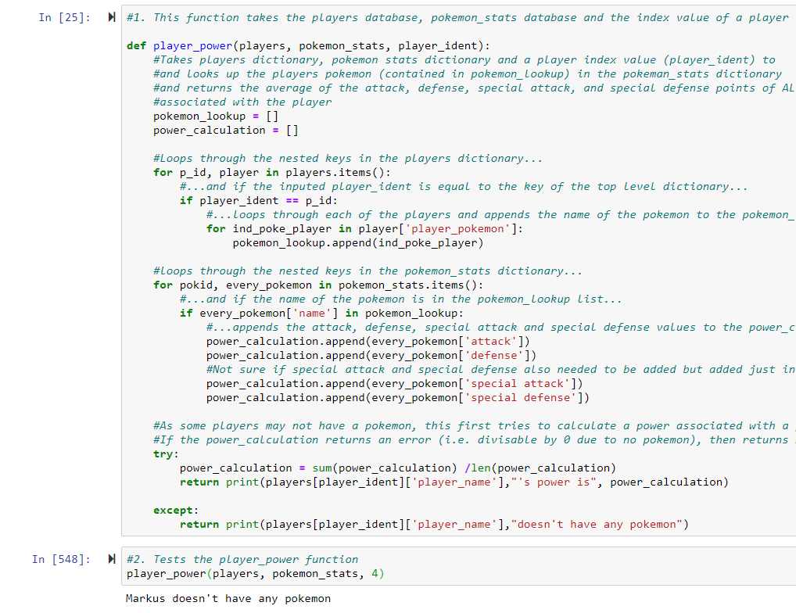
Function in “Focus”
Player power (Q7)
Why picked? – Not sure why just a positive experience
Requirement: Function that calculates a player's "power

Slide 9
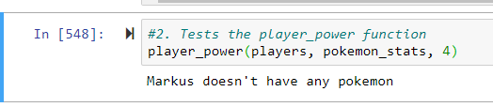
Function in “Focus”
Return/error handling: Trying to consider irregular cases

Slide 10


